Slide 1

Oil Sands Projects
TLM Moment
Lessons Learned

Slide 2

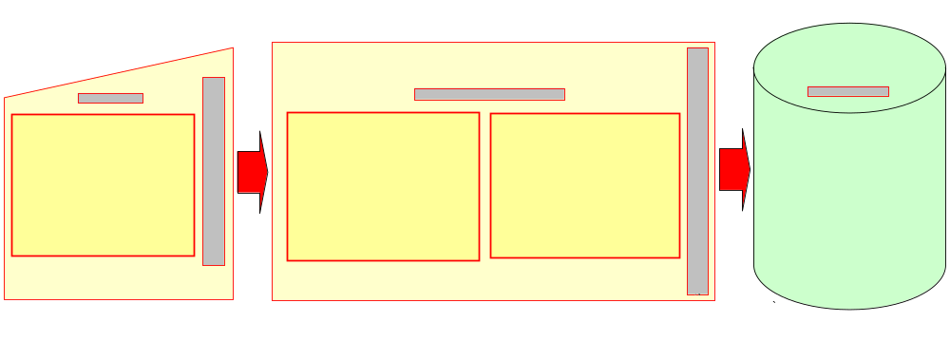
Background
Lessons Learned drive Continual Improvement and Cheaper, Better, Faster Oil Sands Projects
Continual Improvement is ongoing:
  Lessons Learned should be captured as experiences and learnings occur
  Stage Gate Reviews also capture Lessons Learned before moving on to the next project stage

Slide 3
A lesson learned is…
Knowledge (based on experience) of a specific combination of factors (e.g. circumstances, requirements, capabilities, resources) that explains a cause and effect relationship
Which:
  is either positive (success) or negative (failure)
  is significant (beneficial, has an impact)
  is valid (confirmed to be accurate)
  is applicable (identifies a specific process, procedure, model, technology)
  is published and used on future projects - MOST IMPORTANT!!
    an “action LL” where a change has been implemented (procedures, specs, process, standard, etc.)
        OR
    an “awareness LL” to provide insights to future projects

Slide 4
A lesson learned system is……
A means (continuous cycle) of turning raw input (data) into useful knowledge (lessons learned) which:
  directly supports the organization’s ability to learn and continually improve
  is captured primarily in the formal documentation of the organization (e.g. standards, procedures, specifications, models, guidelines, practices, etc)
    captures major learnings in a readily accessible repository
  is supported by the individuals who contribute, participate and use the system and act upon lessons learned

